Slide 1

Ruby Language

Slide 2
About today…
File handling
Read
Write
Append

Slide 3

RUBY
FILE HANDLING

Slide 4
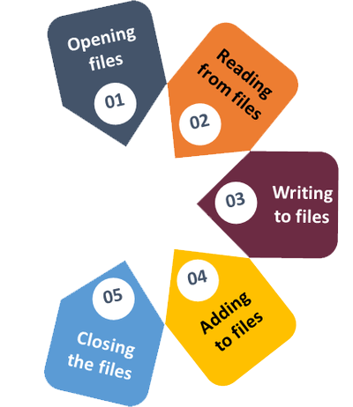
Intro to Ruby File Handling
File handling is an essential aspect of programming for
managing data stored in files
In Ruby, file handling operations include reading from,
writing to, and appending to files

Slide 5

Reading Files
Ruby provides simple methods to read data from files
File.open('filename.txt', 'r')
Opens the file in read mode
file.read
Reads the entire content of the file into a string
file.readline
Reads a single line from the file
file.readlines
Reads all lines into an array

Slide 6

Writing to Files
Writing data to files in Ruby is straightforward
File.open('filename.txt', 'w')
Opens the file in write mode, truncating existing content
file.write('content')
Writes the specified content to the file
file.puts('content')
Writes the content followed by a newline

Slide 7

Appending to Files
Appending data to existing files can be done using append mode
File.open('filename.txt', 'a')
Opens the file in append mode
file.puts('content')
Appends the content to the end of the fil

Slide 8


Slide 9

What method is used to open a file in read mode in Ruby?
How can you append data to an existing file in Ruby?
Which method is used to close an open file in Ruby?
Which mode should be used to open a file in Ruby if you want to both read and write to it?

Slide 10

Task 1
Create a Ruby program that reads the contents of a text file named "data.txt" and displays it on the console.
Task 2
Write a Ruby program that writes your name to a file named "names.txt" and then appends "Welcome to Ruby!" on a new line

